Slide 1
Mindfulness and Meditation
💫 What, Why, and How 💫

Slide 2
What?

Slide 3
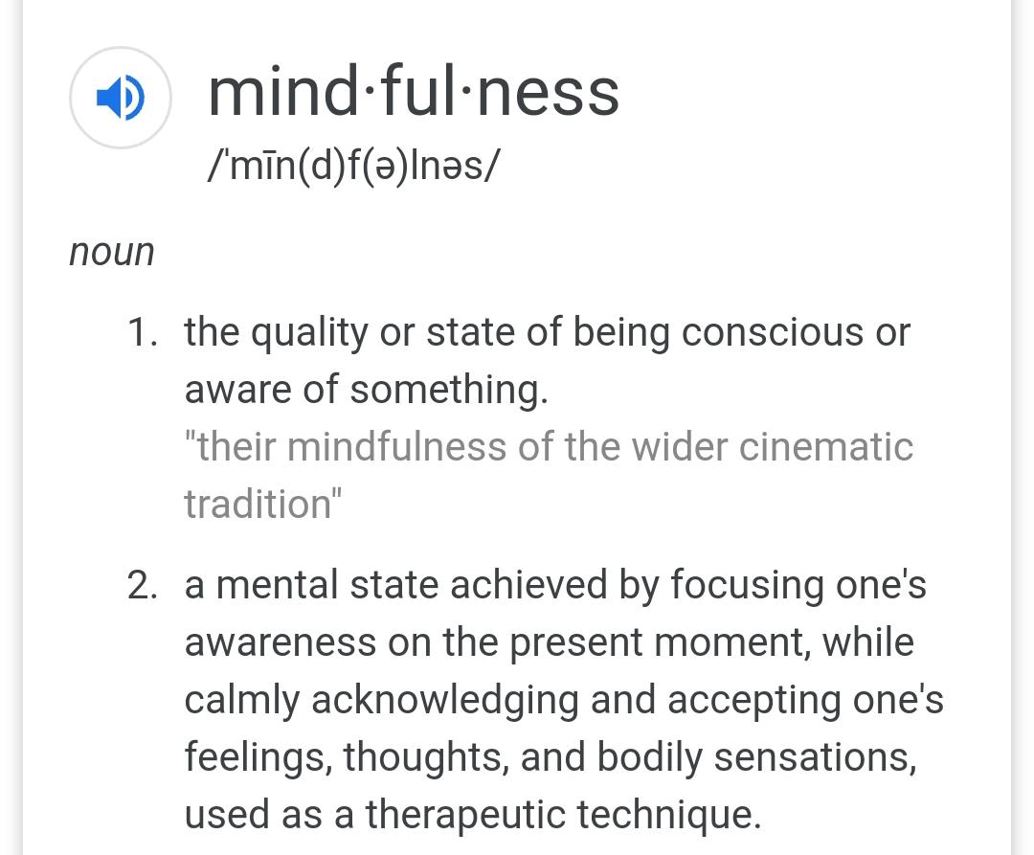

Slide 4
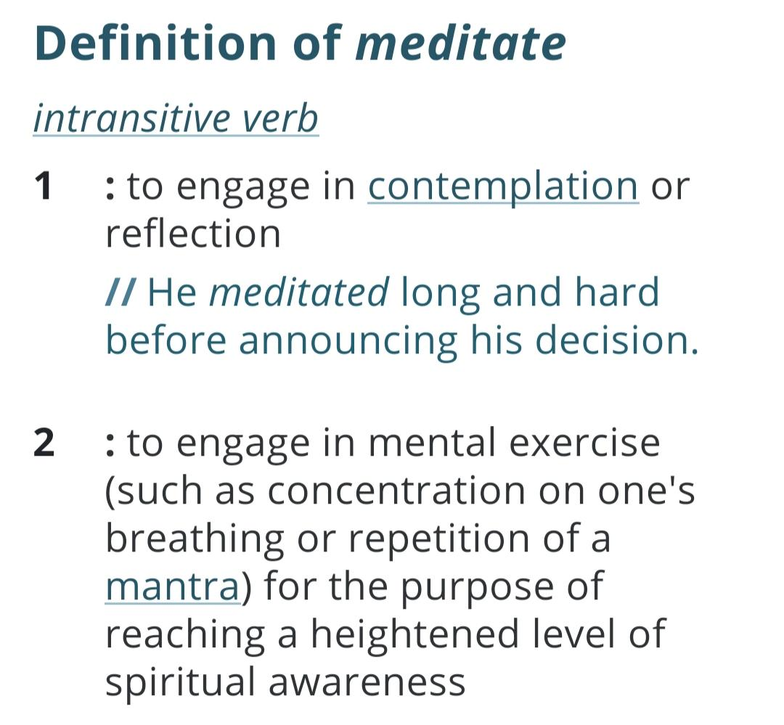

Slide 5
Why???!? 🤔🤔🤔

Slide 6
Your life is the product of your moment-to-moment choices.
Darren Hardy, the Compound Effect

Slide 7
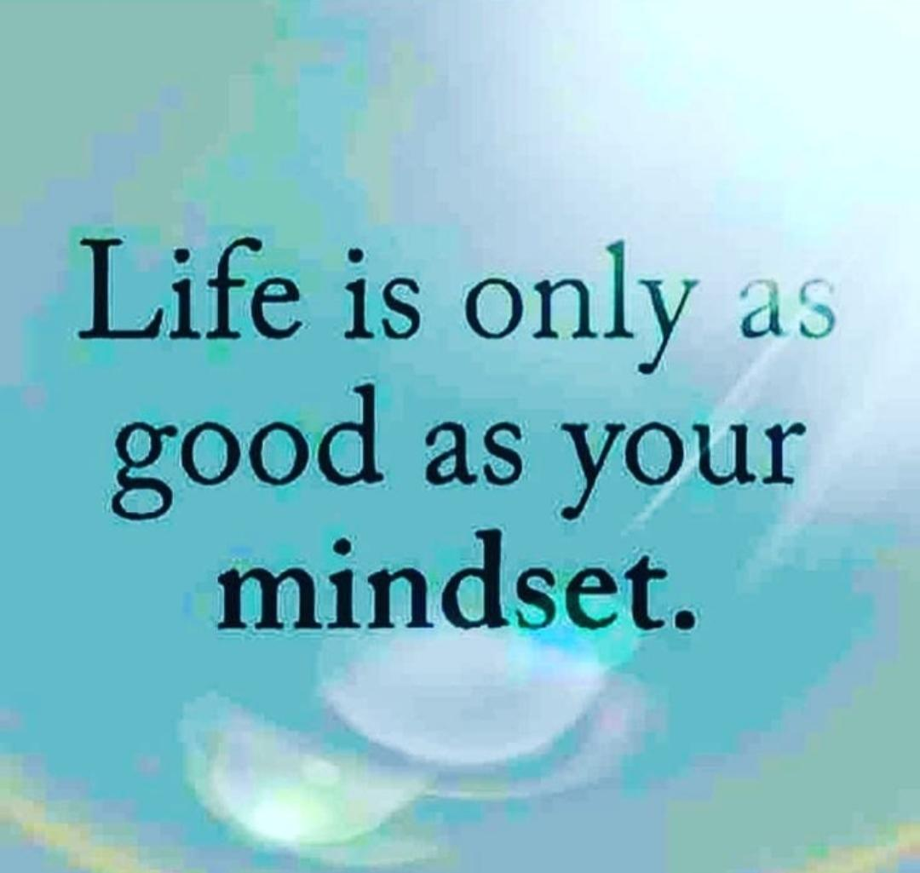

Slide 8
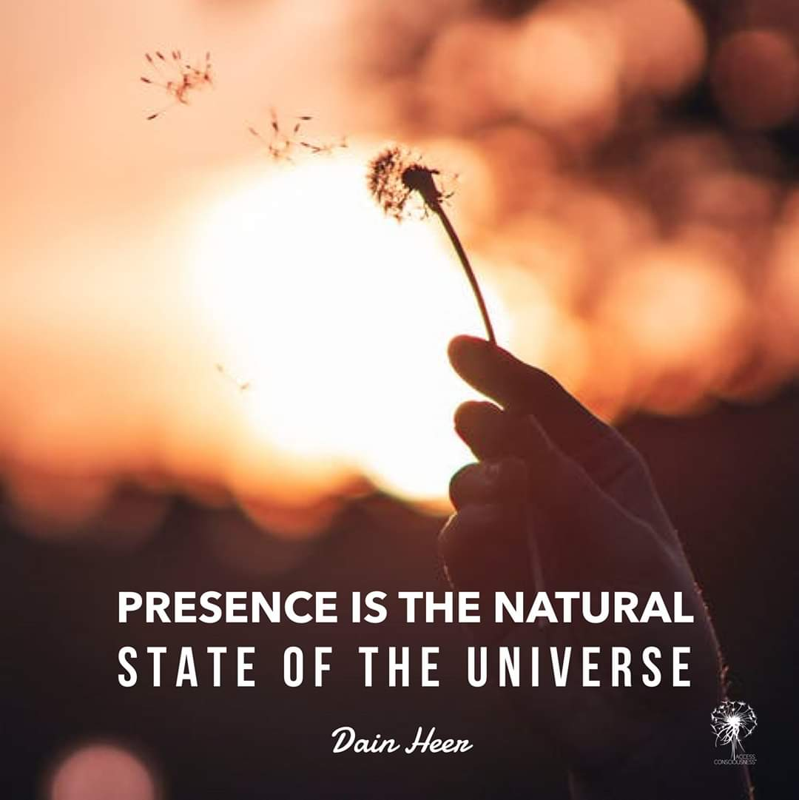

Slide 9
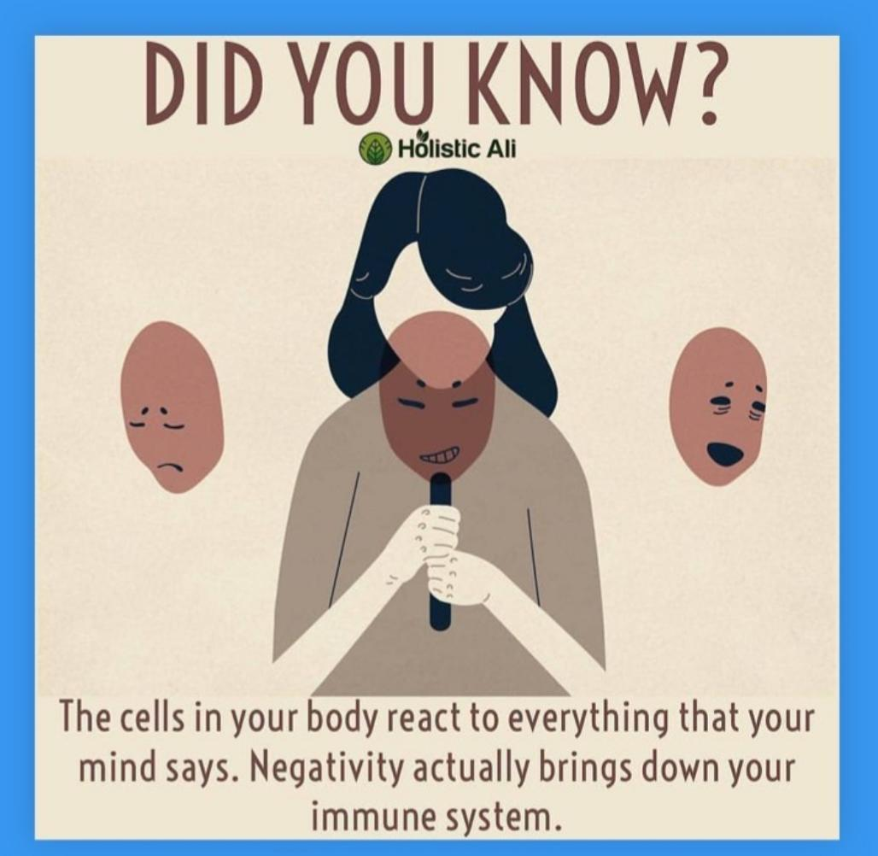

Slide 10
I lovvvve this study from 1993….

Slide 11
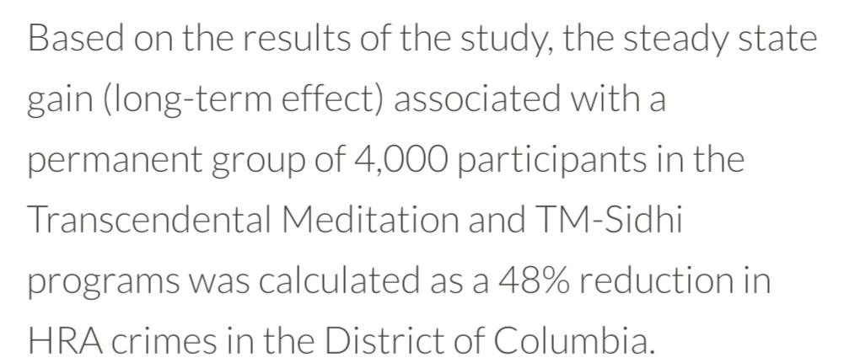

Slide 12
But wait! There's more!

Slide 13
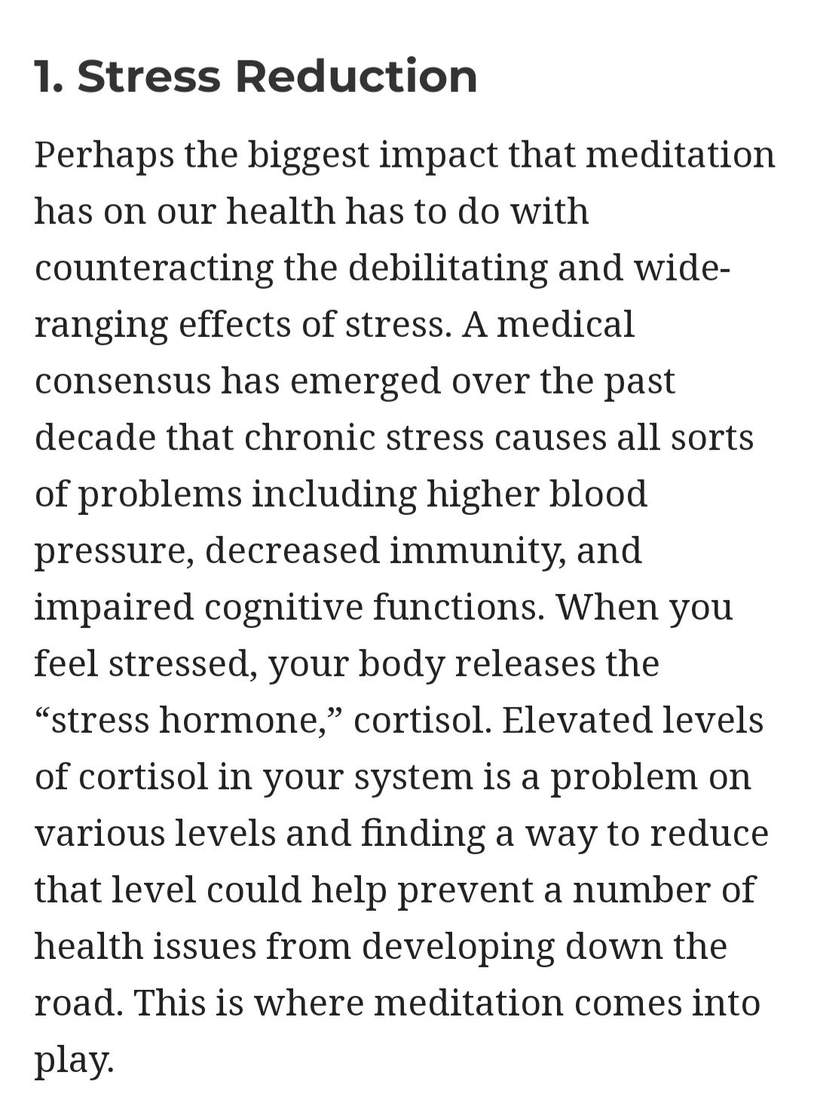

Slide 14
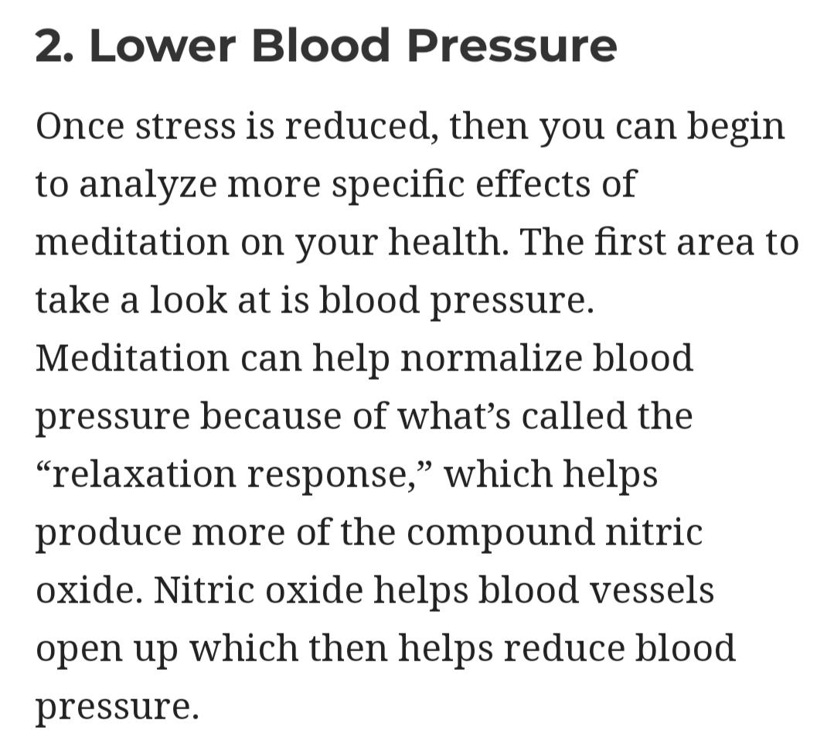

Slide 15
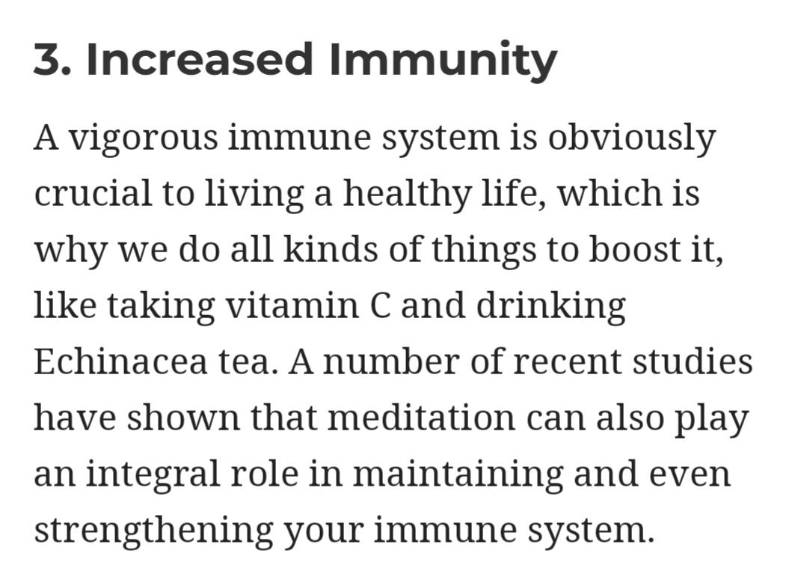

Slide 16
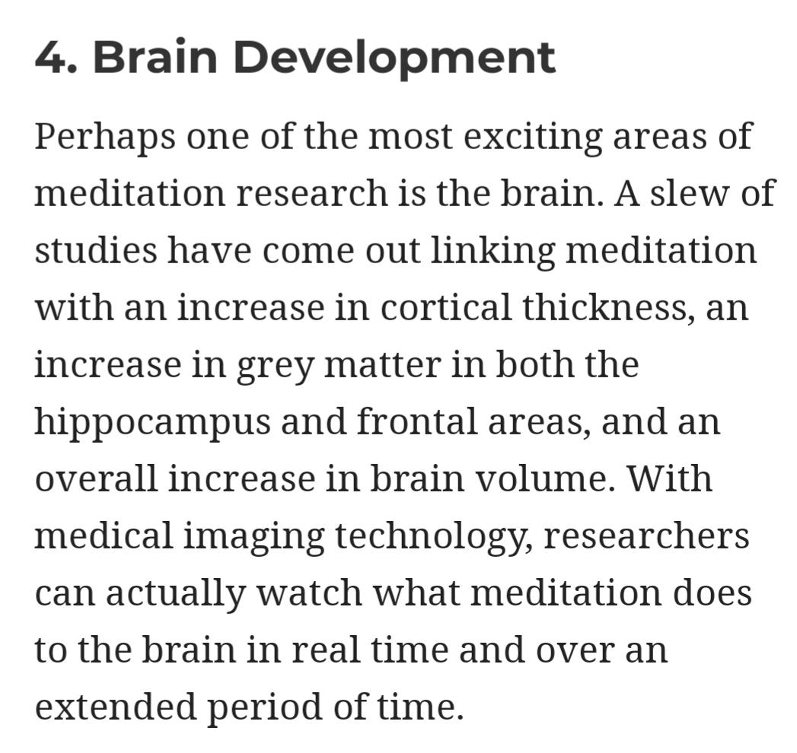

Slide 17
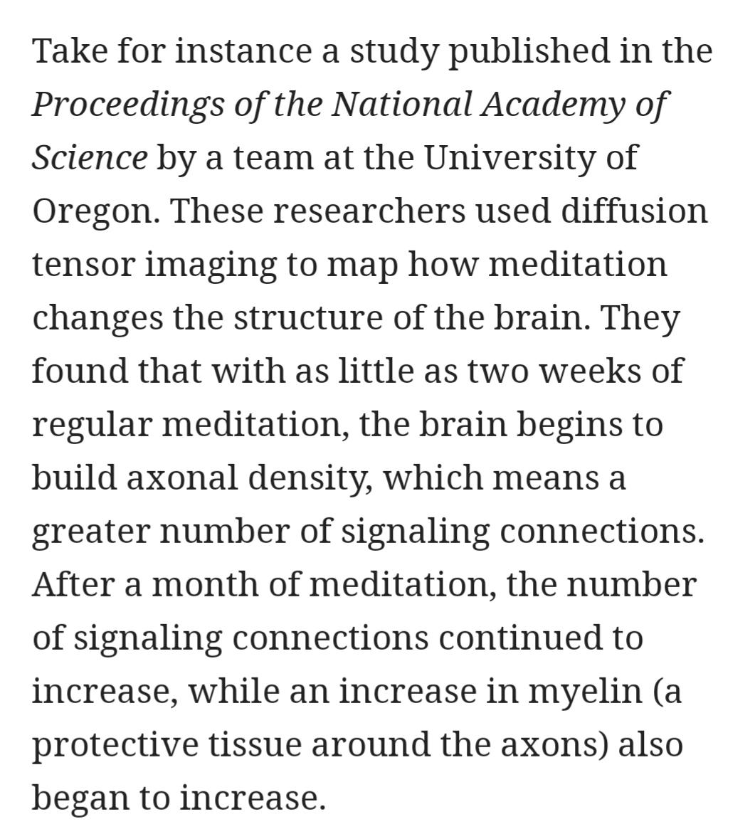

Slide 18
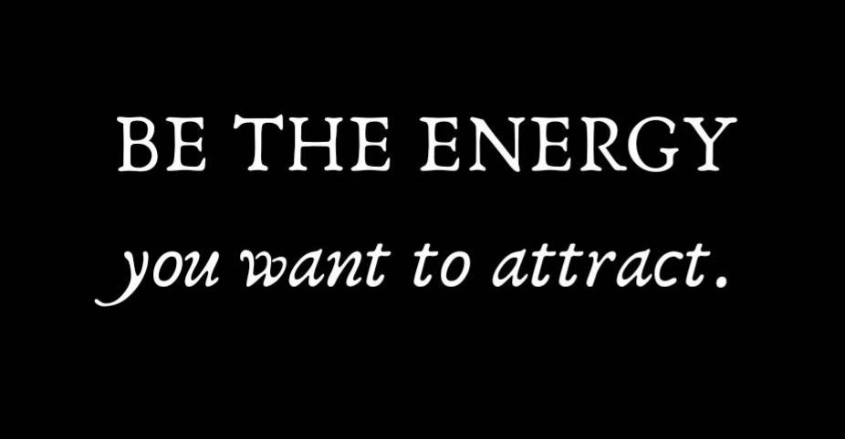

Slide 19
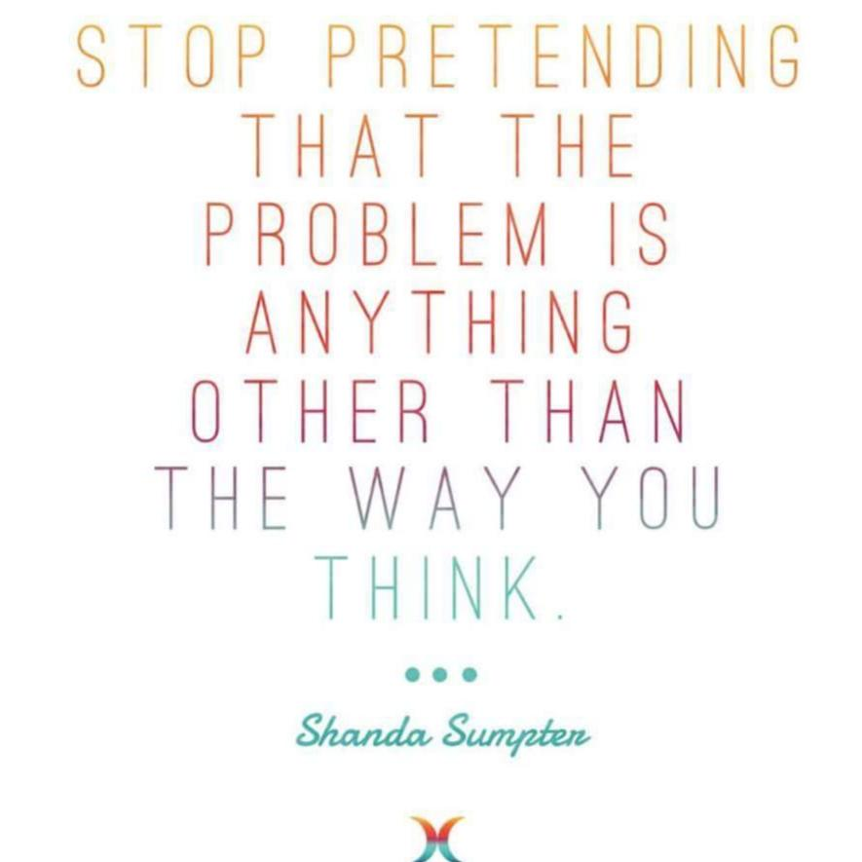

Slide 20
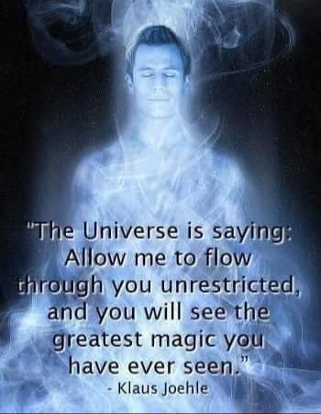

Slide 21
Reel it in, Tess!!!

Slide 22
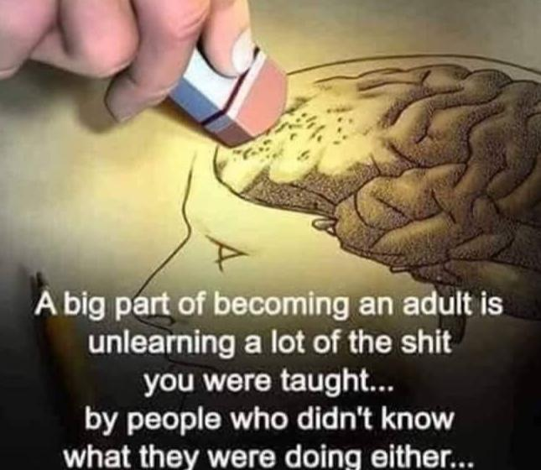

Slide 23
So... . HOW do you consciously unlearn, overcome, and develop a Mindfulness and Meditation practice??

Slide 25
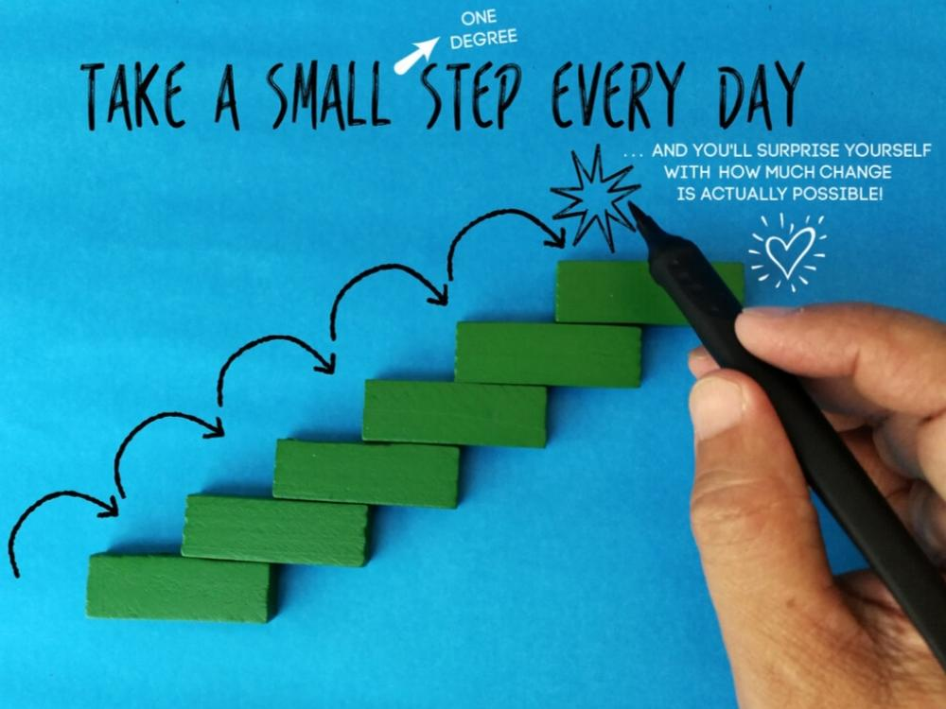

Slide 26
OK cool but actually, HOW?!!

Slide 27
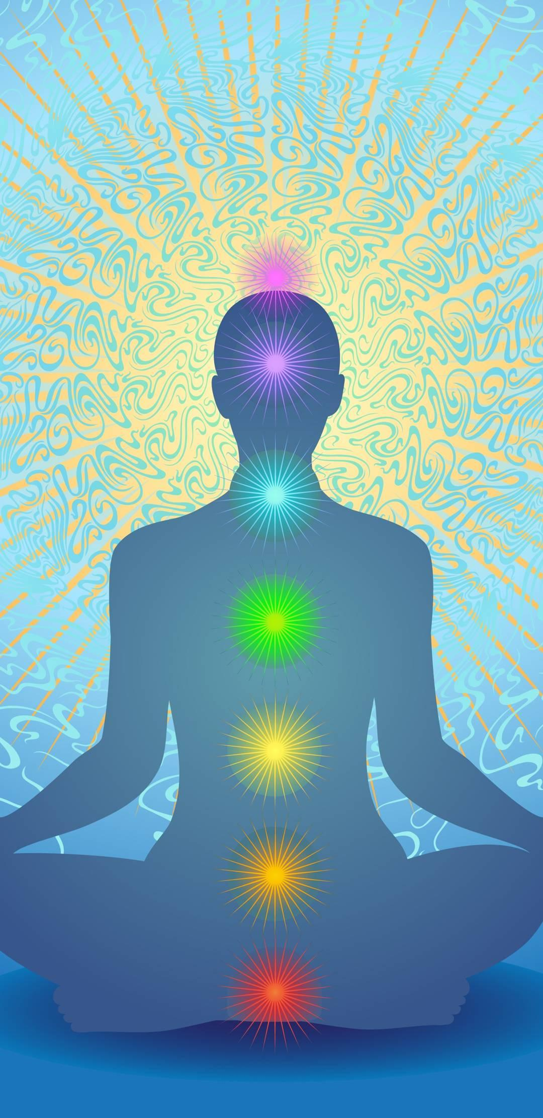
Awareness
Breathing in ___, breathing out ___
Using a mantra or affirmation

Slide 28
And most of all…
❤️❤️ BE kind to yourself. ❤️❤️

